Slide 1


Gender Classification based on Twitter Profile
shahar Dalal
205799976
ofir galai
209458900

Slide 2

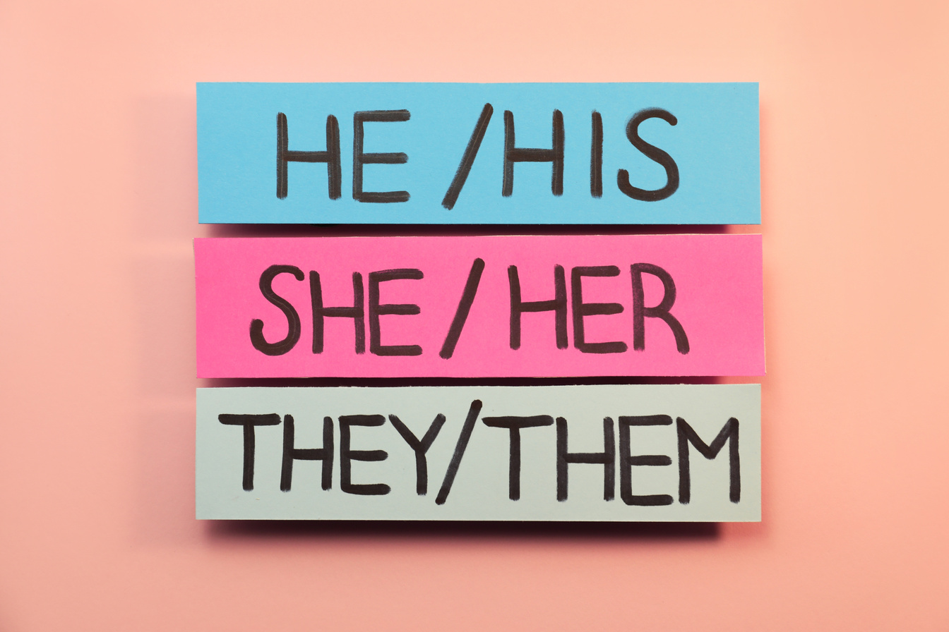

Introduction
X (formerly known as Twitter) is a popular social networking platform for sharing 280-character messages known as tweets.
X has over 330 million monthly active users, with more than 66% being male and 34% female.
Our project aims to classify X users' gender based on profile information and tweets.
02

Slide 3


Research Objectives
Create a labeled dataset for gender classification using a Kaggle dataset with approximately 20,000 users' X data.
Each row includes various attributes, such as user name, a random tweet, account profile, image, location, link color, sidebar color, and more.
The main motivation behind our project is to apply machine learning and natural language processing techniques for gender classification, which has applications in psychological analysis, marketing, forensic investigations, targeted advertising, and combating fake news, election manipulation, and bot activity on social media.
02

Slide 4
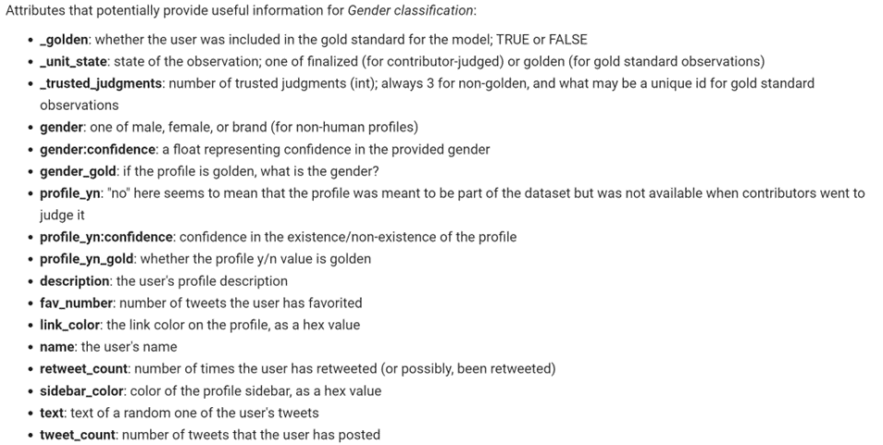

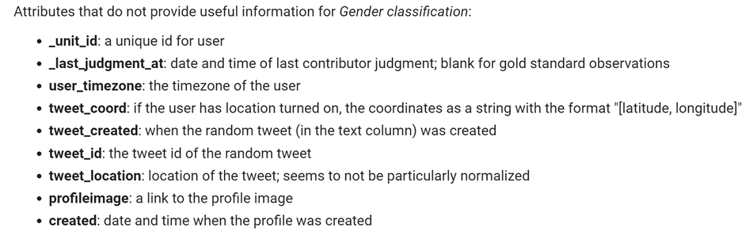

Slide 5

Key Attributes:
Target Variable "gender": At the heart of our classification task lies the "gender" attribute , with values male, female, or brand for non-human profiles.
This is the variable we aim to predict based on the information provided in the dataset.
Additional Attributes: Beyond gender, our dataset boasts an array of attributes, including user names, random tweets, account details, and more, each offering valuable insights into the X users we're analyzing.

Slide 6

Data Cleaning
Importance of Data Cleaning:
Ensuring Accuracy: Data cleaning is like tidying up a room before decorating it. It ensures that our data is accurate and free from errors, setting the stage for reliable predictions.
Enhancing Model Performance: Clean data leads to robust models. By removing noise and inconsistencies, we're optimizing our models' potential for success

Slide 7
Data Cleaning
Specific Data Cleaning Actions:
Irrelevant Columns: Remove columns that do not contribute significantly to our gender classification goal.
Features like :”_unit_id", and others.
Handling Missing Values: Carefully handling missing values.
ensuring they don't compromise the integrity of our analysis.
like instances with missing gender labels due to "profile_yn == 'no'" were thoughtfully eliminated.
With our dataset now cleaned , we're well-prepared to embark on the journey of exploring, modeling, and predicting X user gender

Slide 8
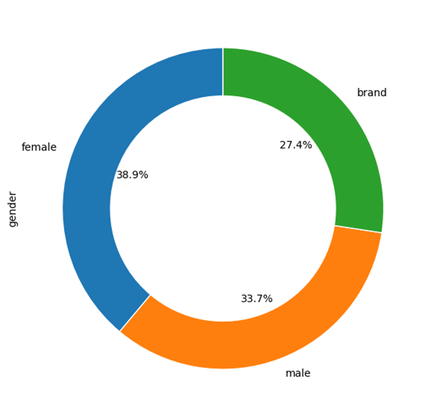
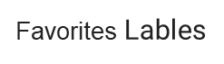
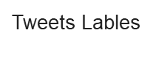

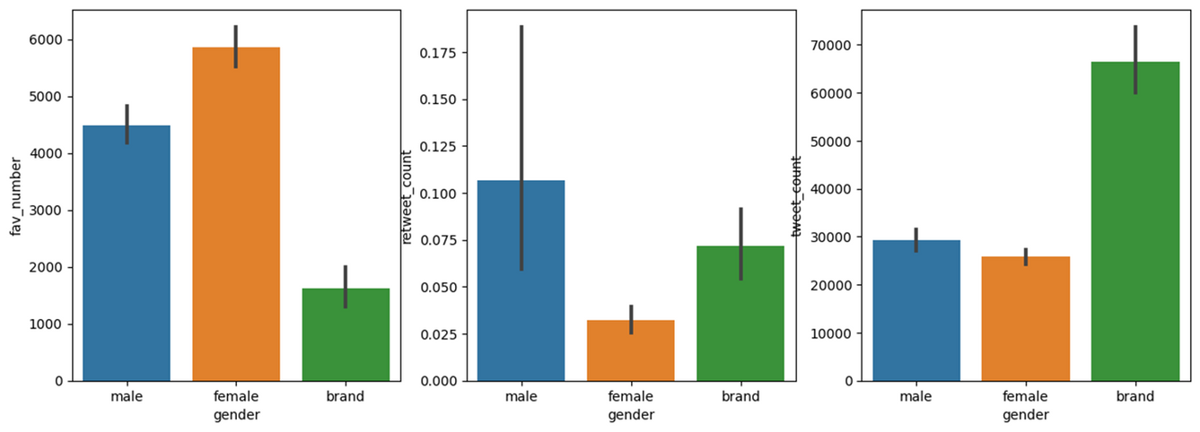
Data Visualization
Data visualization is crucial because it uncovers hidden patterns and relationships in data while also simplifying complex information, making it easily understandable for everyone
Gender Distribution (Pie Chart):
Feature vs. Gender (Bar Charts):

Slide 9
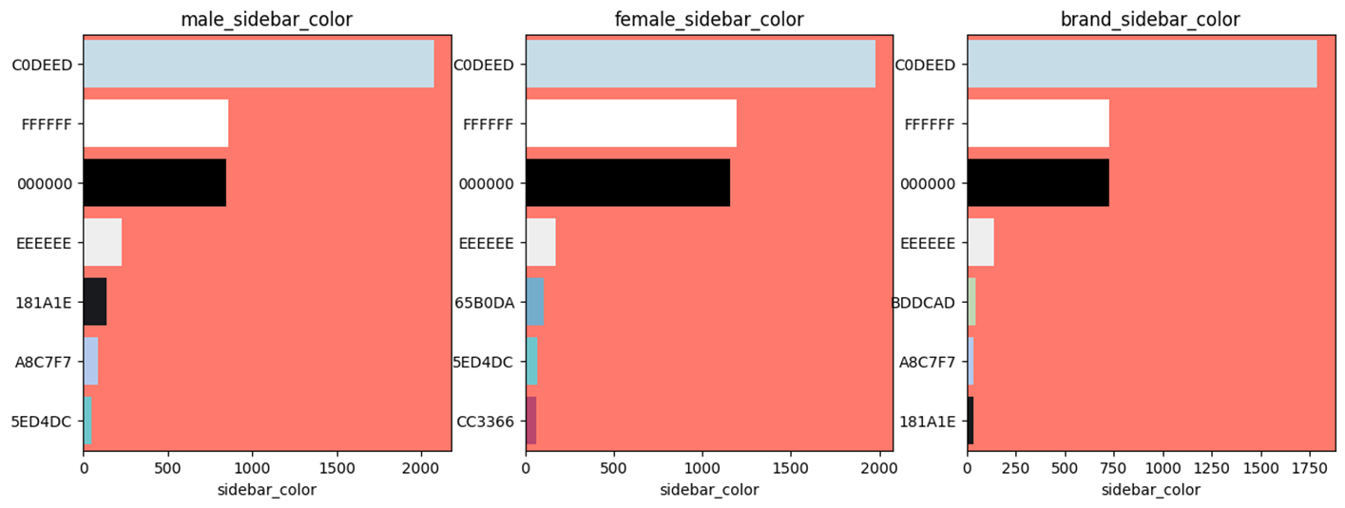
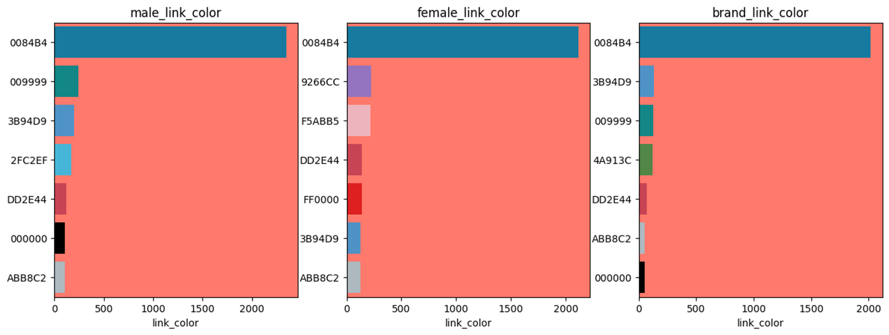

Slide 10

Feature Engineering
Feature engineering is the process of creating new features or modifying existing features to improve the performance of models. Important: Significantly improve performance.
In our project, we've conjured up a new feature called "text_description."
It's a fusion of two crucial pieces of information—tweet text and profile description.
This amalgamation aims to capture more comprehensive insights about each Twitter user.
Combining the essence of what users share in their tweets with their profile descriptions enriches our dataset and equips us with a more potent tool for classification

Slide 11

Handling Categorical Data
Categorical properties represent qualitative variables without structured order. They present unique challenges in machine learning. Our dataset includes features such as "link_color" Label coding is our favorite tool to tame categorical data. It turns categorical values into a numerical format, allowing our machine learning models to process them. Each unique category is assigned a numeric label. For example, different link colors are mapped to specific numeric values

Slide 12

Text Data Preprocessing
Text data preprocessing is vital to convert messy, unstructured text into a clean, structured format for analysis. It enhances machine readability, extracts meaningful patterns, and boosts model performance. Techniques include cleaning to remove noise, tokenization for word-level analysis, and stopword removal to focus on content-carrying words, streamlining text data for effective analysis and modeling

Slide 13
Model Building
Model building is a crucial phase for predictive algorithms, aiming to classify X users' gender. The arsenal includes Logistic Regression for simplicity, Random Forest for ensemble accuracy, Support Vector Machine for data separation, and Complement Naive Bayes for imbalanced datasets, all contributing to informed predictions in this pivotal phase.
we also use another model that use neural network
Model Evaluation
Model evaluation is vital to ensure the accuracy and reliability of predictions. Without it, we risk deploying ineffective models. Evaluation metrics include Accuracy, a fundamental measure of overall correctness, Confusion Matrix for deeper insights, and Classification Report offering detailed metrics like precision, recall, F1-score, and support for each class, enhancing our understanding of model performance

Slide 14

Model Comparison - Tweet-Text Only vs. Concatenating Description to Text vs. Non-Text Features
Three approaches for feature input in classification are described: Text-Only, Concatenated (combining text and user descriptions), and Non-Text (using non-textual attributes). Each approach has distinct advantages and trade-offs. Text-Only is efficient for pure text but lacks user context. Concatenated captures both text and user info, offering balanced performance. Non-Text includes diverse attributes but ignores linguistic patterns. The choice depends on the specific goals and trade-offs in our classification task

Slide 15
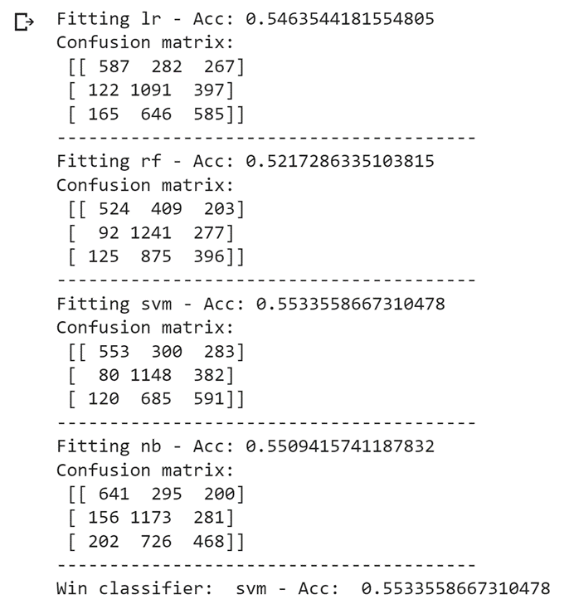
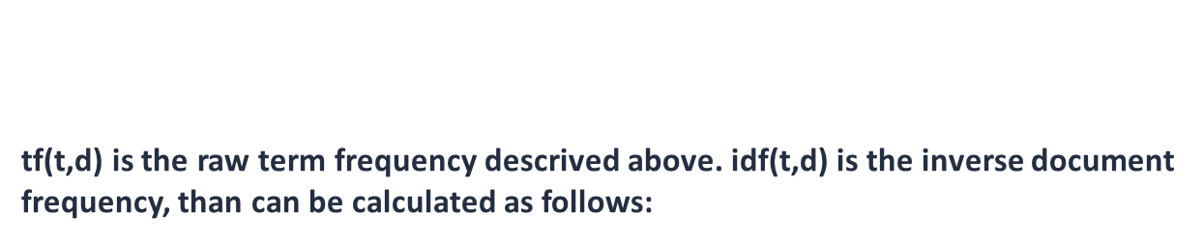
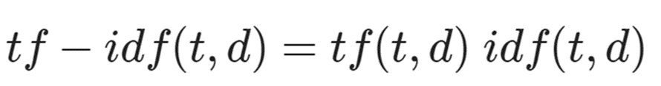
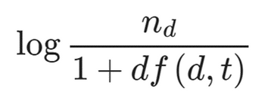
Classification Modeling - With Tweet-text Only
TF-IDF (Term Frequency-Inverse Document Frequency) is a method used to score words in text data for information relevance. It addresses the issue of common words having high scores by considering term frequency (how often a word appears in a document) and inverse document frequency (how unique a word is across all documents). The formula combines these two factors, with IDF giving more weight to rare terms. This process helps prioritize words that are more informative and less common in the corpus, making them more suitable for analysis and classification

Slide 16
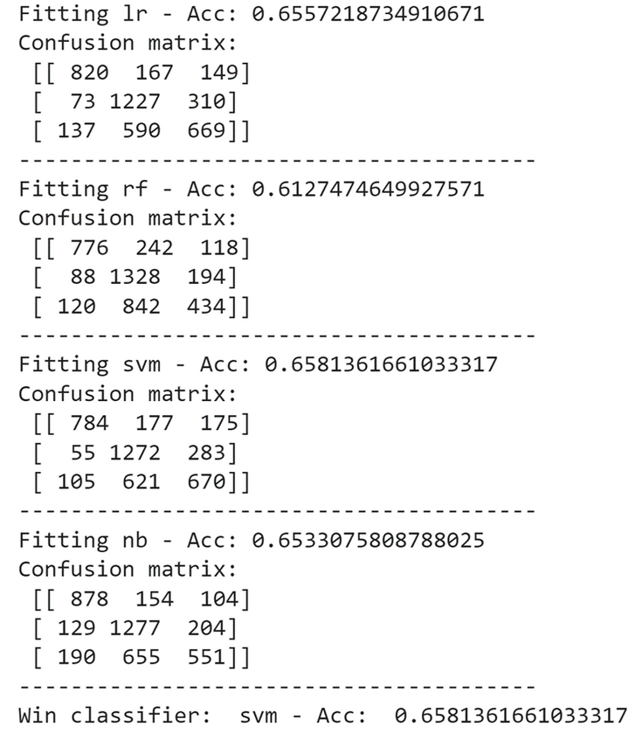
Classification Modeling - Concatenating description to text
In the data preprocessing steps, you've combined tweet text and user descriptions while maintaining readability. This enriched dataset now includes the concatenated feature for enhanced feature interpretation. To make the data suitable for machine learning, categorical gender labels were encoded into numerical values. Additionally, label encoding was applied to categorical features like link_color and sidebar_color using a frequency-based approach, improving feature representation without increasing dimensionality

Slide 17
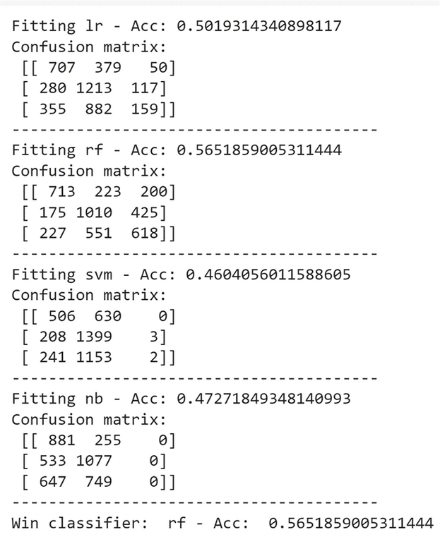
Classification Modeling - With Non-Text Features
This phase involves integrating non-text features from the dataset for classification, providing additional information beyond text data. Categorical gender labels are transformed into numerical values for compatibility with machine learning algorithms. Categorical features like link_color and sidebar_color are handled using label encoding based on category frequency, enhancing feature representation without increasing dimensions. An ensemble classifier is employed, combining models trained on both text and non-text features to leverage their strengths. The accuracy score of this ensemble classifier is presented as a measure of model performance, emphasizing the effectiveness of combining text and non-text features for classification

Slide 18

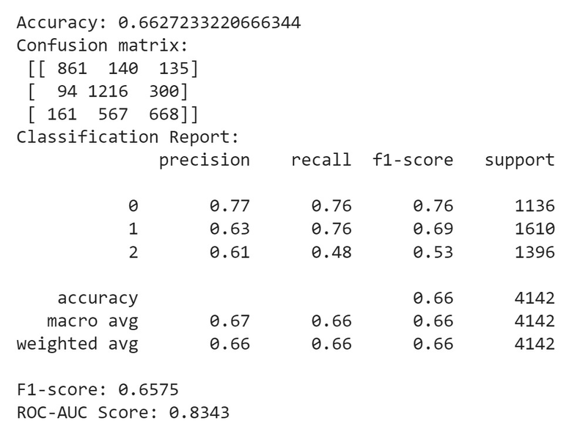
Ensembling: Combining Models for Improved Accuracy
Ensembling techniques were applied in this project to enhance classification accuracy. When combining models trained on both text and non-text features, an ensemble achieved an accuracy of about 58.64%. In a separate experiment using ensemble classifiers for text data only, which included Logistic Regression, Complement Naive Bayes, and Support Vector Machine, an accuracy of approximately 66.27% was achieved. This underscores the potential for significant accuracy improvement through ensembling, especially when combining models from different data sources or using various algorithms. Further experimentation and fine-tuning could lead to even better results

Slide 19

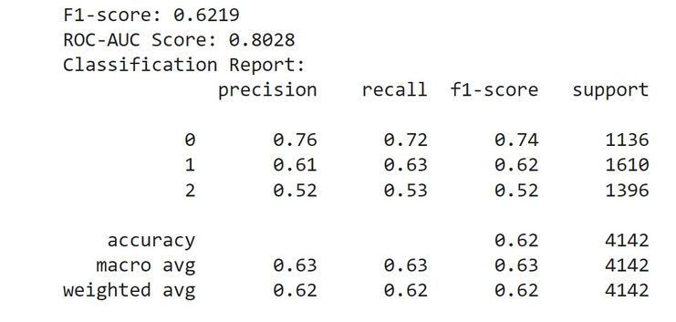
neural networks
Creates a simple neural network model with an embedding layer for word representation, a flattening layer, a dense layer with ReLU activation, a dropout layer for regularization, and a final dense layer with softmax activation for classification into three classes (male, female, brand).
this neural network model starts by embedding words into numerical vectors, applies non-linearity through ReLU activation, uses dropout for regularization, and outputs class probabilities for gender classification into three classes. It's designed to learn and capture patterns in the input text data to make predictions about the gender of X users

Slide 20

Conclusion
A baseline model was developed for gender classification using a Kaggle dataset, highlighting the challenges of this problem compared to sentiment analysis. Tweet text alone achieved moderate accuracy, but incorporating user descriptions significantly improved classifier performance. Models trained on non-text features faced limitations and require further feature engineering. An ensemble approach with both text and non-text data yielded an accuracy of 58.64%, showing potential for improvement in this complex task

Slide 21

Future works
Explore advanced natural language processing techniques for better tweet text analysis.
Investigate deep learning models, such as neural networks, to capture complex patterns.
Incorporate additional user-related features like account creation date or follower count.
Conduct sentiment analysis in conjunction with gender classification for richer insights

Slide 22


